Slide 1
Change the background photo by deleting it, and replacing.
Then change the color fades based on photo and design needs.
RMTLC Health Subcommittee Meeting
April 19
Montana Healthcare Foundation | 2022
MTHCF.ORG

Slide 2
Change the background photo by deleting it, and replacing.
Based on photo you can add a transparent color box on top to fade it out.
Change the transparency in the ”Shape Format” tab.
Supporting the Planning of Tribally Led Regional Substance Use Treatment Center in Montana

Slide 3
Update
AIHL group requested MHCF support an in-depth Tribal Substance Use Disorder Needs Assessment
Scope of work under review from Health Management Associates
AIHL requested MHCF support the continued planning while the needs assessment is being completed.
RFP Drafted
MHCF researching possible consultants/groups

Slide 4
Approved Tribal Resolutions in support of the continued planning in partnership with MHCF
RMTLC
Little Shell Tribe
Fort Peck
Rocky Boy
CSKT
Blackfeet

Slide 5
Request for Proposals
The consultant will support a complex planning process that includes designing a service model, designing a facility, developing a staffing and business plan, and helping the tribes determine the best leadership structure (i.e. forming a non-profit and delegating authority to bill at the tribal all-inclusive rate; creating a tribal consortium, or another option).
The Montana Healthcare Foundation will be helping to fund and coordinate this effort, but we are also seeking a consultant that has deep expertise working with tribes, and understands how to center self determination and self governance throughout the planning process.

Slide 6
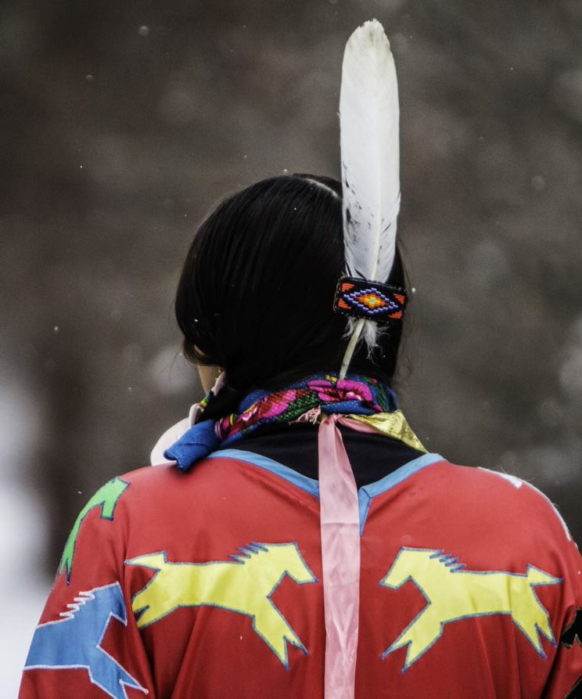
7 Directions Architects/Planners
Daniel Glenn, Principle Architect
Recently planned a residential treatment center for the Colville Tribe
Experience with programming, design, site location and business planning
Experience working with Montana Tribes
Montana projects include:
University of MT Payne Native American Center
Little Big Horn College Master Plan
Apsaalooke Nation Capital Complex

Slide 7
Kaufman & Associates
Based out of Spokane, WA
Founded in 1990 and is an American Indian and women owned management consulting firm
Expertise in public health, education and economic development
Experience working with Montana Tribes and urban Indian health centers
Unknown if they have experience with facility design and financing

Slide 8
Indigenous Pact
A Certified B Corporation, Native American owned and Public-Benefit Corporation based out of Washington
Works with Tribes to develop sustainable revenue, increasing access and improving health outcomes for Native Americans
Some experience working with Montana Tribes
Worked has mostly been focused in Washington and on Opioid Treatment programs
Project with CSKT

Slide 9
Beaux-Simone Consulting
Zoe LeBeau
Extensive, successful experience with design/finance/build-outs of supportive housing projects with Tribes throughout the country
No direct experience with clinic/health care service planning and design
Currently working with Blackfeet, Northern Cheyenne and CSKT Housing departments
Offered to assist with investigating consultants within her network

Slide 10
Arete Development Group
Jason Campbell
LLC based out of Missoula
One person consulting firm
Experience in renewable power generation and power distribution
Some experience working with Montana Tribes

Slide 11
Clause Law P.L.L.C.
Terra Branson
National Tribal non-profit management
Federal compacting and negotiations
Law firm experienced with working with Tribes
Little Shell Tribes attorney

Slide 12
Other Considerations
Tribal Healthcare Consultants
2-person shop that mainly offers interim management services
Owl Springs Consulting
2-person shop, based in Navajo/Southwest
Seem to focus on self-governance and clinic design
Native American Development Corporation
Dr. Donald Warne, University of North Dakota
DWSG Architecture

Slide 13
Discussion
Do you know any other companies or individuals that should be on this list?
Do you have suggestions about how to find consultants with the experience we need?
Do you have any serious concerns about any of the organizations on this list?

Slide 14
Next Steps
Issue RFP to qualified stakeholders
Bring viable proposals back to AIHL group for review

Slide 15
Thank You.
777 EAST MAIN STREET, SUITE 206
BOZEMAN, MONTANA 59715
INFO@MTHCF.ORG | 406 451 7060
MTHCF.ORG

