Slide 1
Billings Area Indian Health service

Slide 2
2021 Budget & COVID-19 Funding
BILLINGS AREA FY 2021 FUNDING | Federal | Tribal | Urban | Total
Clinical Services | 57,384,363 | 35,112,381 | 467,515 | 92,964,259
Preventive Health | 5,388,760 | 7,399,173 |  | 12,787,933
Urban Health |  |  | 4,421,356 | 4,421,356
Purchased Referred Care | 52,373,224 | 20,538,015 |  | 72,911,239
Contract Support Costs |  | 13,962,676 |  | 13,962,676
Special Diabetes Program Initiative | 1,044,343 |  |  | 1,044,343
3rd Party Collections | 101,301,402 |  |  | 101,301,402
Environmental Health/Facilities, | 21,592,528 | 2,568,389 |  | 24,160,917
COVID-19 Relief Funding | 79,131,757 | 31,937,529 | 10,092,025 | 121,161,311
American Rescue Plan Act Funding | 131,578,319 | 82,207,549 | 19,409,094 | 233,194,962
 | 449,794,696 | 193,725,712 | 34,389,990 | 677,910,398

Slide 3
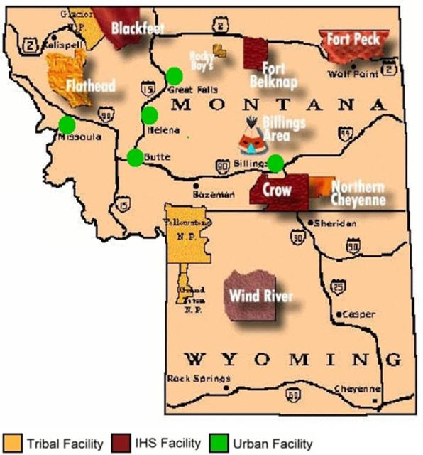
COVID-19 Testing
Montana is reporting high transmission statewide with a seven (7) day COVID-19 positivity rate of 17.2% and 457 new cases per 100,000 population in the last 7 days.
Wyoming is classified as high transmission statewide due to seven (7) day COVID-19 test positivity rates 11.3% and 394 cases per 1000,000 population in the last 7 days.
All Tribal, Urban and Federal sites continue to offer COVID-19 testing.
*125,700 total COVID-19 tests performed
9,191 positive patients identified
Active cases (six federal sites): 210

Slide 4
COVID-19 Vaccinations
Billings Area IHS, Tribal & Urban (Age 12+):
Total administered : 57,031
Population fully vaccinated: 46%
Montana:
Total administered : 45,330
Population fully vaccinated: 48%
Wyoming:
Total administered : 11,701
Population fully vaccinated: 40%
*IHS 12-15 year old demographic: 46% partially vaccinated, 34% fully vaccinated.

Slide 5
COVID-19 Vaccine
COVID-19 vaccines currently offered are Pfizer-BioNTech, Moderna and Janssen (Johnson & Johnson)
Comirnaty® (fully FDA approved version of Pfizer-BioNTech) is expected to roll out in November once the stock of Pfizer BioNTech vaccine is depleted.
Comirnaty ® and Pfizer-BioNTech have the same formulation and can be used interchangeably to provide the COVID-19 vaccination series for individuals age 12 and over
BOOSTERS:
The CDC recommends a booster dose of Pfizer-BioNTech vaccine at least 6 months after the second dose of the primary series for certain individuals who received the Pfizer-BioNTech vaccine as the primary series.
65 years and older
Age 18+ who live in long-term care settings
Age 18+ who have underlying medical conditions (including cancer, chronic kidney disease, chronic lung diseases, diabetes, heart conditions, etc.)
Age 18+ who live or work in high-risk settings (health care, schools, correctional facilities, homeless shelters)
Moderna and Janssen booster doses and “mix and match” (heterologous) booster doses were reviewed by the FDA and regulatory action is pending. The Moderna booster dose will be half the dose of the primary series dose.
The CDC’s ACIP will meet on October 21, 2021, to review the FDA decisions and make clinical recommendations on Moderna and Janssen booster doses as well as heterologous booster dosing.

Slide 6
COVID-19 Vaccine
Pediatrics:
FDA review of the Pfizer vaccine for pediatrics (age 5-11) will be October 26, 2021.
CDC’s ACIP will meet on November 2 & 3, 2021 to make clinical recommendations
Moderna EUA for adolescents (ages 12-17) is pending with an uncertain timeline.
Moderna expected to submit data to the FDA for pediatrics (ages 6-11) in November or December.
Moderna expected to submit data to the FDA for pediatrics (ages 2-5) in early 2022.

Slide 7
COVID-19 Therapies
MONOCLONAL ANTIBODIES
Billings Area sites have seen increased use of Regen-COV over the last few months. Six (6) sites have now administered Regen-COV to 143 patients as of 10/6/21.
Regen-COV can now be given subcutaneously which has allowed its use at outpatient only clinics.
Regen-COV can be given for post-exposure prophylaxis under EUA to individuals ages 12+ who are at high risk for progression to severe COVID-19 and are:
Not fully vaccinated OR fully vaccinated but immunocompromised AND
Have had close contract to an individual infected with COVID-19
Who are at high risk of exposure to an individual infected with COVID-19 due to institutional settings
Regen-COV can be given for treatment of COVID-19 under EUA to individuals ages 12+ with positive results of viral testing and who are at high risk for progression to severe COVID-19

Slide 8
Questions?

