Slide 1
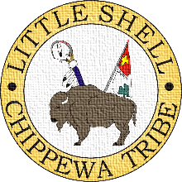
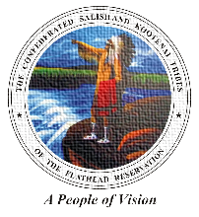
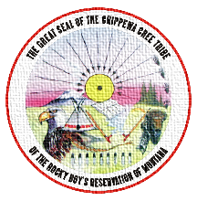
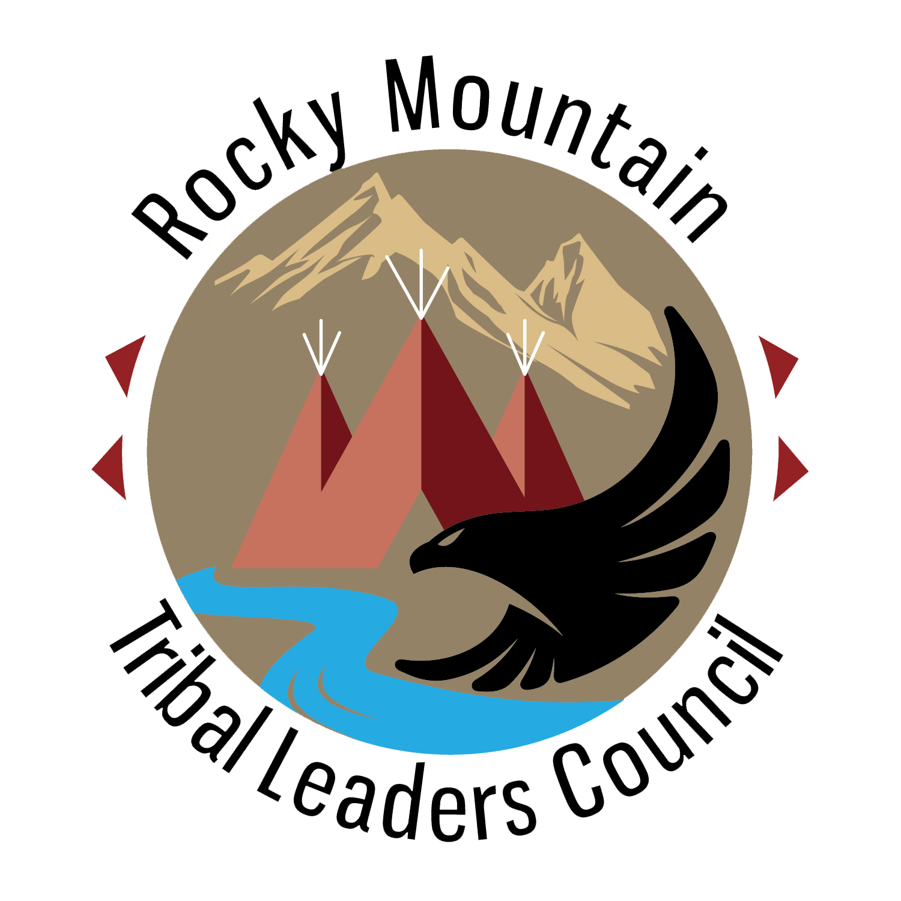
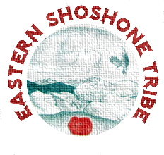
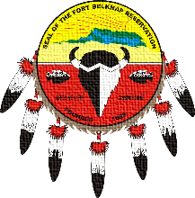
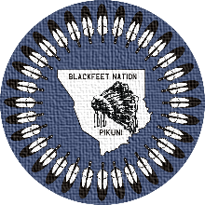
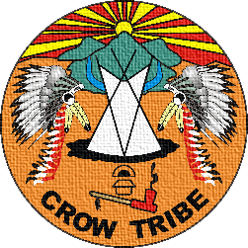
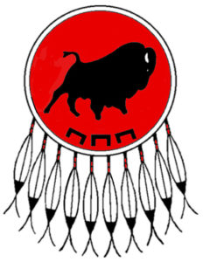
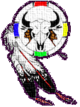
Nutrition 101 Part 4 The indigenous edition
ROCKY MOUNTAIN
TRIBAL LEADERS COUNCIL
Tribal Opioid Response Program
Notes:
Rocky Mountain Tribal Leaders Council presents Nutrition 101, The Indigenous Edition.

Slide 2
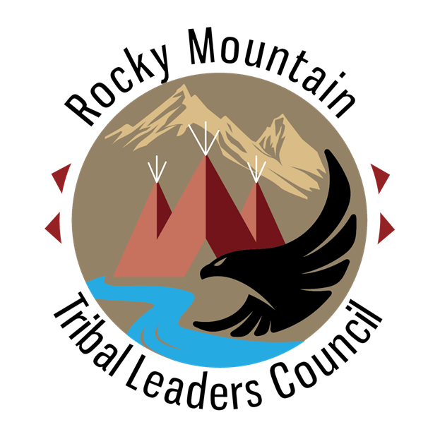
OPIOID USE DISORDER CAN LEAD TO MALNUTRITION, NUTRIENT DEFICIENCIES, METABOLIC DISORDERS
Malnutrition is a general concern with substance use disorders because of inadequate nutrient intake.
Opioid use disorder has been associated with decreased levels of several micronutrients, including vitamins and minerals.
Chronic opioid use can lead to deficiencies in B vitamins which can play a role in developing colon cancer and liver disease, and can lead to mental disorientation, and depression.
Protein malnutrition and reduced bone mass is also common.
Diet’s Role in Opioid Recovery By Carrie Dennett, MPH, RDN, CD Today’s Dietitian, Vol. 23, No. 1, P. 42
Notes:
Read as is. Malnutrition is a general concern with substance use disorders because of inadequate nutrient intake. Opioid use disorder has been associated with decreased levels of several micronutrients, vitamins and minerals. Chronic use can lead to deficiencies in B vitamins, which can play a role in developing colon cancer and liver disease, and can lead to mental disorientation and depression. Protein malnutrition and reduced bone mass is also common.

Slide 3
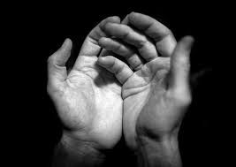
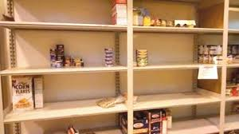
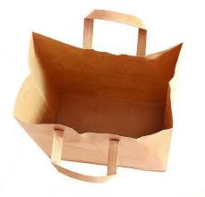
What do you do if…..?
Situations aren’t ideal
Times are tough
Money is tight
Notes:
So far in this series we have focused on typical ways to look at eating for better health. But what do you do when those things aren’t available? Or even possible? Money gets tight, situations aren’t ideal and times do get tough. What can you do to get by?

Slide 4
Check resources
Local food banks
Meal programs
Food trucks
Discount food stores
Notes:
What resources are in the area you live. Is there a local food bank or shelter that offers food. Can it be picked up or delivered? Are there free lunch or meal programs in local centers or parks? Discount food stores can help to stretch limited funds. Food trucks can offer lower cost meals, especially at the end of the day.

Slide 5
Commodities!
Notes:
Remember commodity foods! Commodity foods are designed to provide nutrition in shelf stable forms of food such as canned fruits and vegetables, powdered milk and dried rice and beans. Rice and beans can make a large amount of food and be paired with other items to help make a more filling meal. Beans are an excellent source of protein and fiber too.

Slide 6
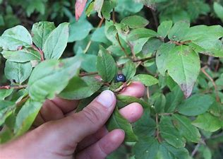
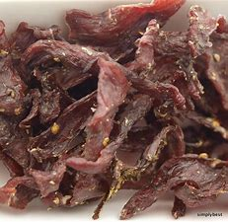
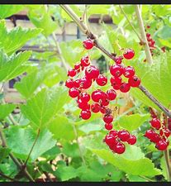
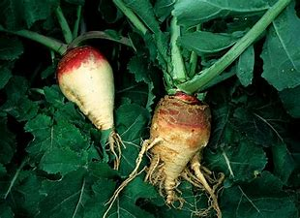
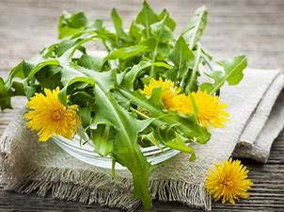
Indigenous foods
Berries
Roots
Game
Dried Meat
Plants and Herbs
Notes:
Traditional indigenous foods are all excellent sources of nutrition and can be found seasonally. Foods that are found seasonally are placed at the right time that the body needs those nutrients found in the food. If you are able, hunt and gather food to share with those who aren’t able, especially the elders. Providing for other members of the community keeps us connected to our families, clans and culture and strengthens the bonds of our heritage. There are many traditional plants and herbs have healing properties and can be prepared as foods, teas, and medicines. When we use medicines from our culture, they can provide spiritual healing by reconnecting us to our ancestors.

Slide 7
THE MEDICINE WHEEL
FUTURE
SOCIAL
PAST
PHYSICAL
Eternal
Four Colors
Four Races of Man
Many Gifts of Man
Wholeness
Cyclical
Universality
Four Directions
Vibrant Pathways
Spiritual Center
Spiritual Binding
Harmony & Balance
Interconnectedness
Holistic Approach
Stages of Development
TOMORROW
INTELLECTUAL
TODAY
EMOTIONAL
Notes:
Many Indigenous people try to balance traditional and mainstream views of health and healing. Traditionally, health is viewed holistically and is comprised of the physical, mental, emotional and spiritual aspects of our lives. Being healthy means living in harmony and balance. Illness occurs when an individual is out of harmony, and healing is a process of restoring balance. One aspect of health is believed to affect the others; addressing a problem in one area will help heal problems in other areas .
A holistic view also means that prevention and treatment are not divided but seen as part of the same process. The medicine wheel conceptualizes our connectedness to the universe about us. Stemming from a spiritual core, it provides a holistic view of the self and connection to family and the world. It teaches that we are part of a kinship system that begins with family and spreads to the community, tribal affiliation, nation and extending out.

Slide 8
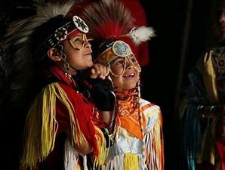
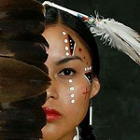
Seven Generations
Notes:
Remember the Seventh Generation. The responsibility and well being of future generations rests on every generation that comes before them. If we act and make decisions that have the best interest of the Seventh Generation, our future descendants, then we will engage in behaviors that ensure healthy future generations of American Indians and Alaska Natives.

Slide 9
CONTACT
Tribal Opioid Response Program
Rocky Mountain Tribal Leaders Council
2929 3rd Avenue North Suite 300
Billings, MT 59101
Phone : 406.252.2550
Notes:
Thank you. Be well and be healthy. A’ho.

