Slide 1
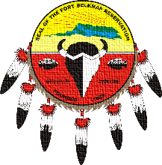
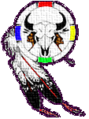
Nutrition 101 Part 3
ROCKY MOUNTAIN
TRIBAL LEADERS COUNCIL
Tribal Opioid Response Program
Notes:
Rocky Mountain Tribal Leader’s Council Tribal Opioid Response Program presents Nutrition 101, Part 3, Healthy Living Every Day

Slide 2
Eat for health
Eat for health, pick from different foods and colors, and be healthy and well.
Notes:
Keep things simple and focus on eating for health, pick from different foods and colors, and be healthy and well. This will help the body start to heal and recover.

Slide 3
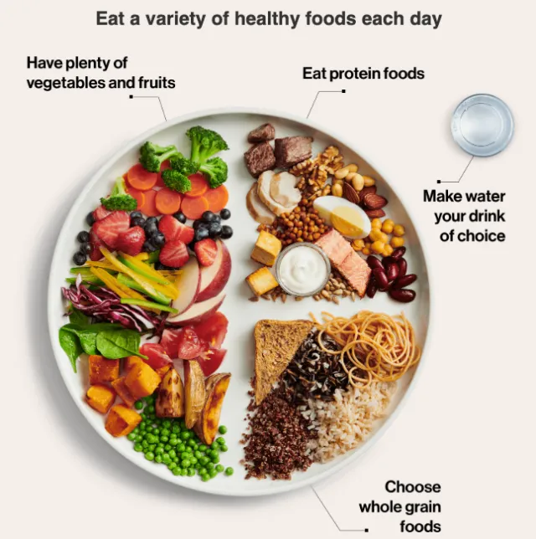
Bring it together
Healthy food is part of a healthy life.
Keep it balanced.
Notes:
Healthy food is just one part of a healthy life. A healthy life is what recovery is about. Life, and food, are about balance. You don’t want to have too much of anyone one thing.

Slide 4
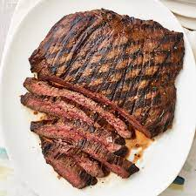
How to be healthy every day
Keep it simple! Start with one thing.
Notes:
Being healthy is easy if you keep it simple. Start with one small thing to build on and add too it from there. Choose one food that is healthy and make it the base of your meals. Protein is an easy choice to build the rest of your meal around. Usually all that is needed are a few vegetables.

Slide 5
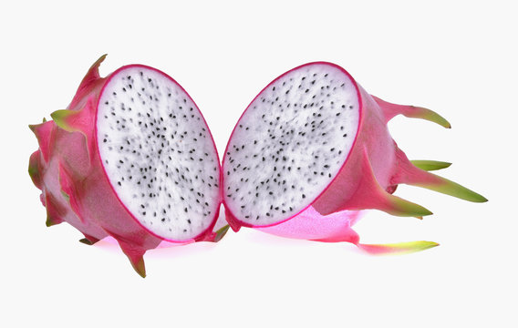
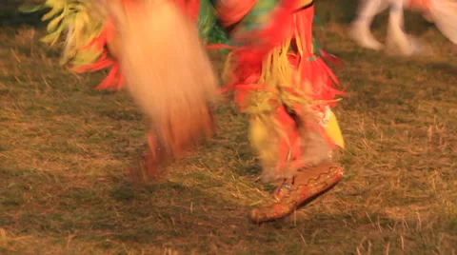
Try one new thing. OK, two…
Try one new vegetable, fruit or even a whole recipe each week.
Try one new habit each week, like walking around the block instead of having desert. Or do something you enjoy, just move!
Notes:
Add one new food and one new habit each week or two. Try to experiment with one new vegetable, fruit or recipe each week. Also try adding one new habit each week, like walking about the block instead of having dessert. Or go out for a hike and picnic on Saturday or Sunday instead of sitting down to watch TV. You can even start doing more of an activity you already enjoy. By focusing on just one thing at a time, you will not get overwhelmed and things will feel easy to achieve instead of impossible.

Slide 6
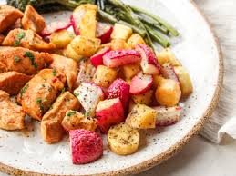
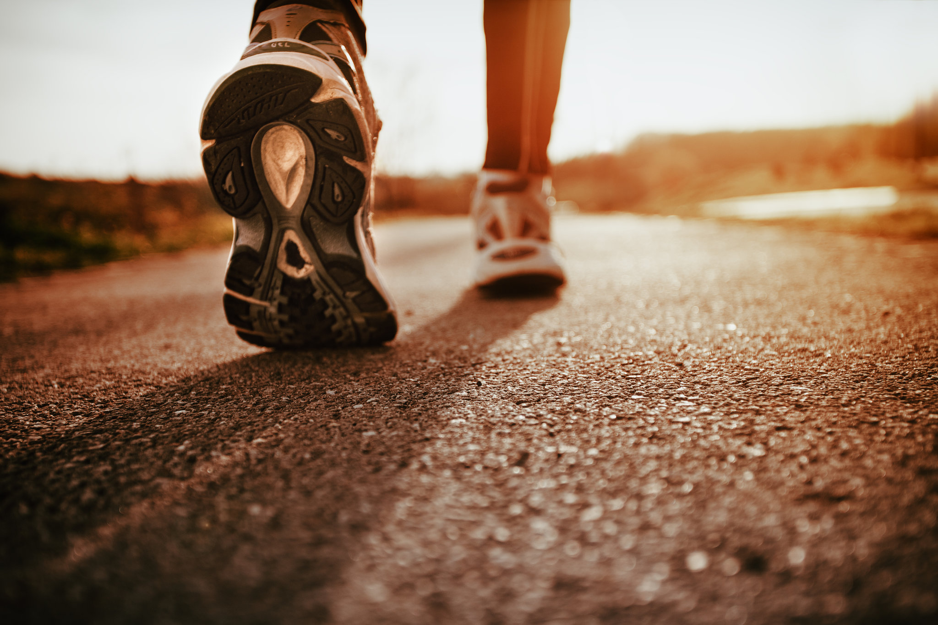
Focus on Activities
Focus on things you CAN do instead of things you can’t.
It’s about the doing, not the thing!
Notes:
Think about the things you CAN do. Your grocery is out of fresh vegetables? Look for frozen. No frozen? Try canned. You are still getting a vegetable! Cook simple meals. Cooking for yourself is a way to care for yourself.
Focus on the activity you are doing and not the result you are trying for. You have control over your activities!

Slide 7
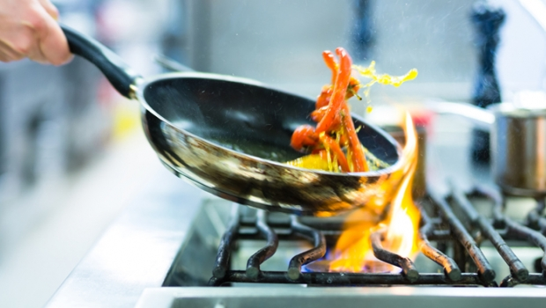
Build on your strengths
Start with something you enjoy.
Notes:
Start with something you enjoy. Love cooking? Experimenting with new foods and recipes is building on that strength and by focusing on trying new vegetables, fruits and recipes, you are building on your health too. Then try making just a little extra to have a healthy option for the next day as a lunch or later in the week for an easy supper. Don’t care for the kitchen? Try challenging yourself with easy one pan meals, or make one big pot of your favorite meal and freeze it for later.

Slide 8
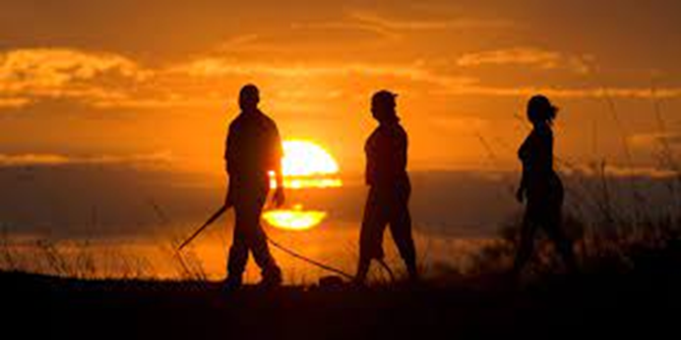
Celebrate your success
Celebrate the things you do accomplish!
Notes:
Everything you accomplish is an achievement to celebrate. Focus on the number of accomplish you have ONE day, then the next and the next. Pretty soon you will have a whole week of accomplishments. And then a month. Eventually you will have an entire year of small accomplishments. Small accomplishments can add up to a big change over time.

Slide 9
CONTACT
Tribal Opioid Response Program
Rocky Mountain Tribal Leaders Council
2929 3rd Avenue North Suite 300
Billings, MT 59101
Phone : 406.252.2550

