Slide 1
Nutrition 101 Part 2
ROCKY MOUNTAIN
TRIBAL LEADERS COUNCIL
Tribal Opioid Response Program
Notes:
Rocky Mountain Tribal Leader’s Council Tribal Opioid Response Program presents Nutrition 101, Part 2 , Building blocks.

Slide 2
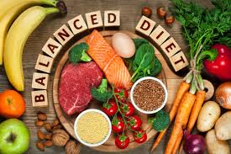
Building Blocks of the Body
Carbohydrates, proteins and fats are broken down into the nutrients our bodies need to rebuild and repair.
Notes:
Carbohydrates, proteins and fats are broken down into smaller components, vitamins, minerals, phytonutrients and amino acids. These are the building blocks of the body’s tissues.

Slide 3
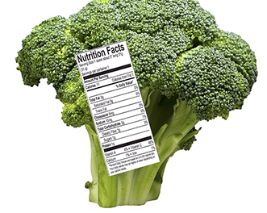
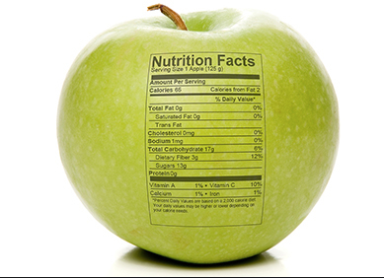
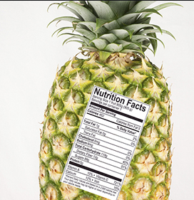
Fruits, Vegetables and Complex Carbohydrates
The BULK of any diet.
Notes:
Vegetables and fruits should make up the BULK of any diet. They are loaded with vitamins and minerals as well as fiber which helps with feelings of fullness and rids the body of toxins.

Slide 4
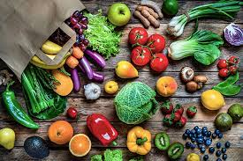
Fruits, Vegetables and Complex Carbohydrates
The majority of your plate should consist of vegetables, fruits and complex carbohydrates.
Notes:
Read as is.

Slide 5
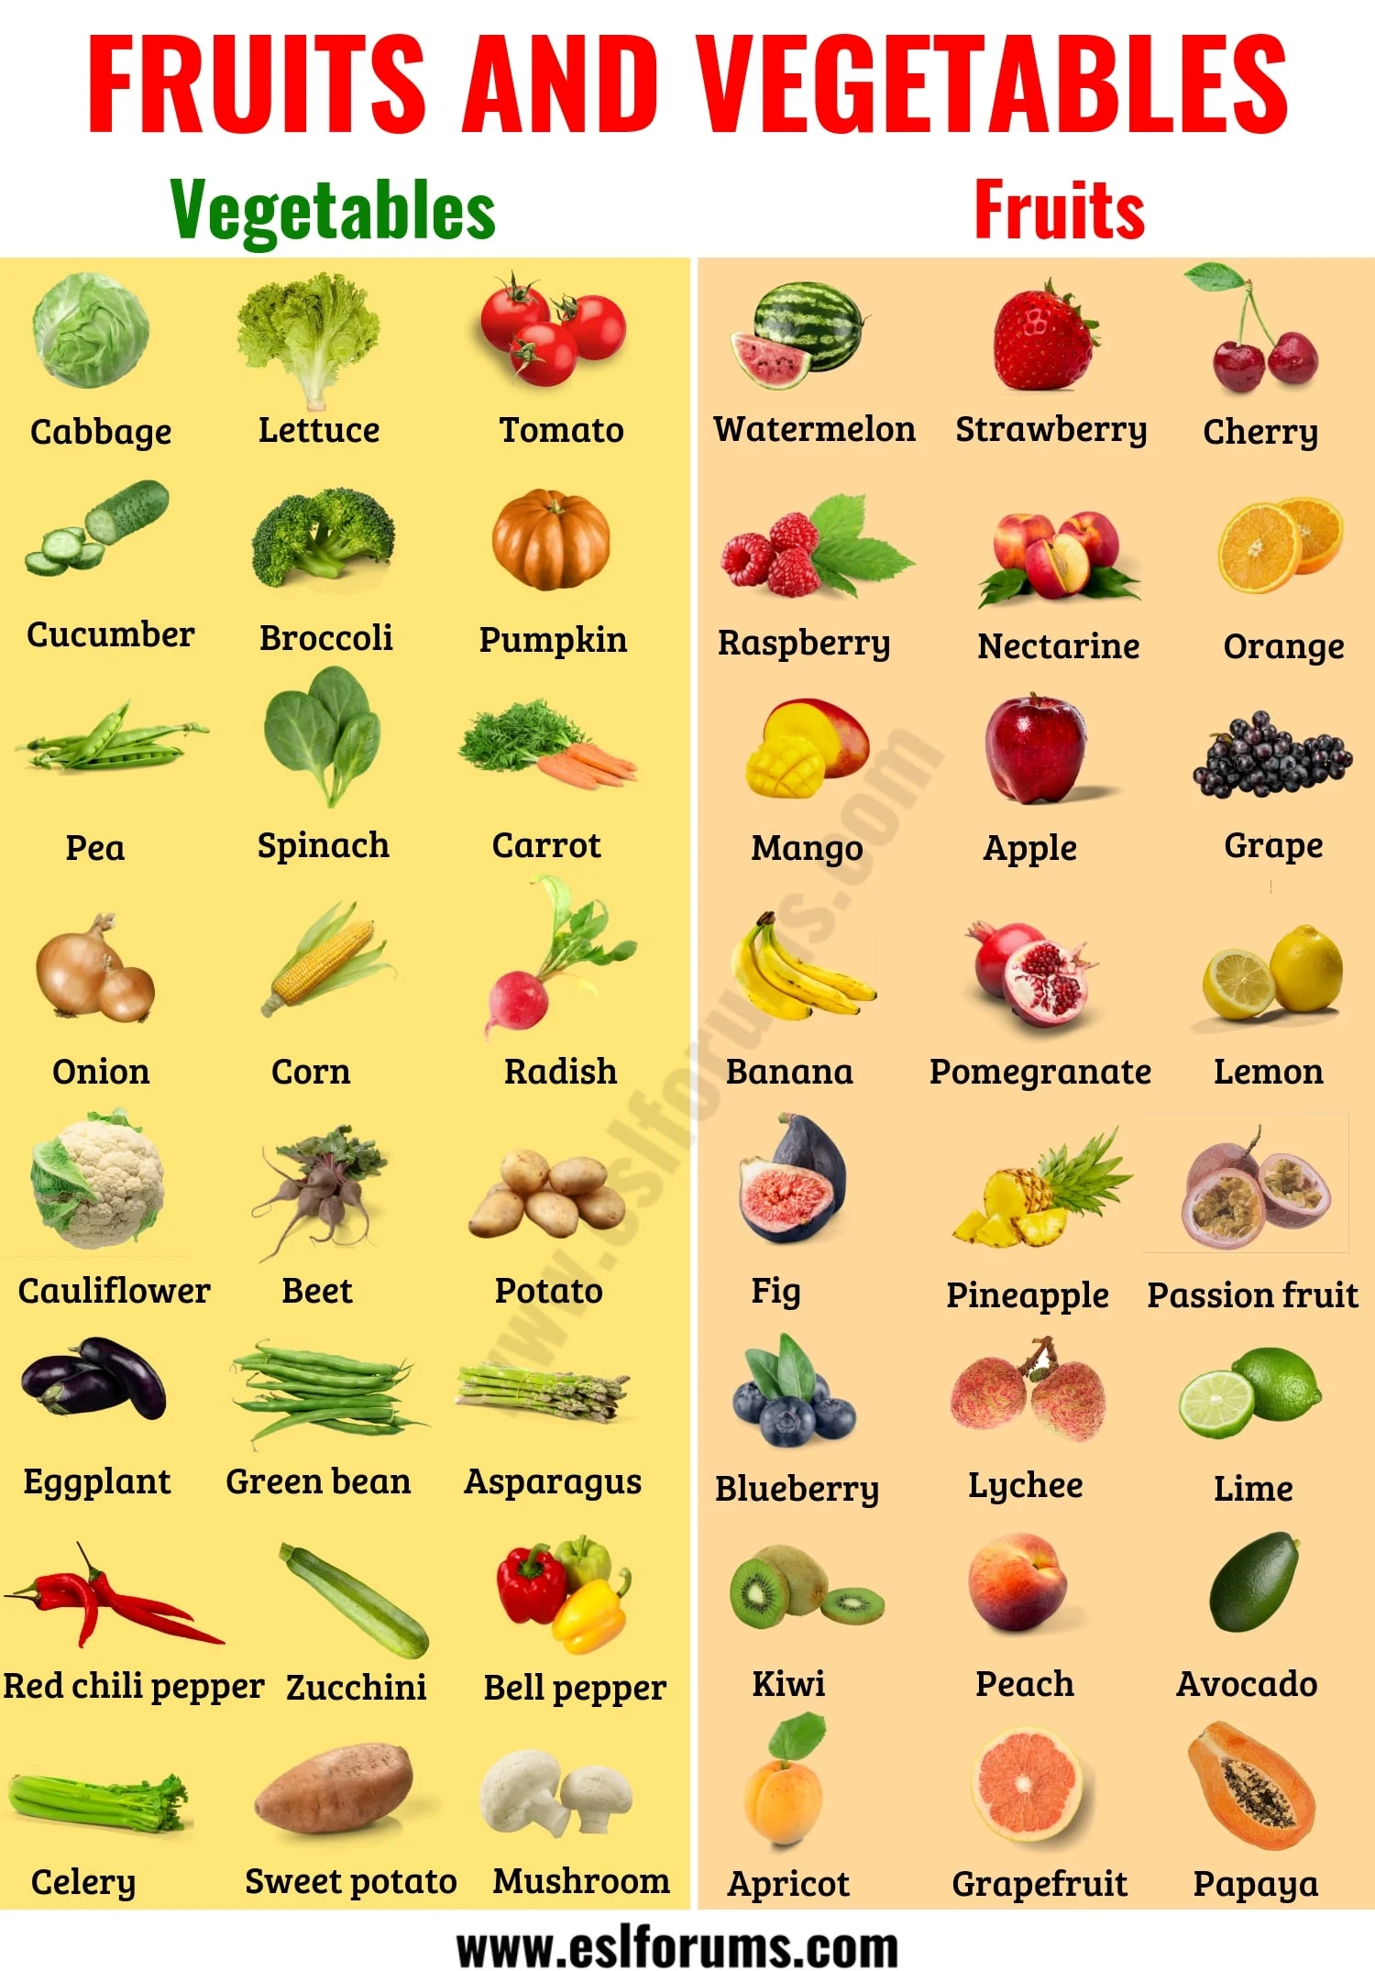
Fruits and Vegetables
Fruits and vegetables are good sources of vitamins and minerals and fiber. Fiber helps feelings of fullness. Focus on a variety of colors.
Notes:
By filling your plate with vegetables and fruits, you will be getting a variety of important nutrients to help the body function. When your plate is full of these items, you will also have less room for unhealthy foods.

Slide 6
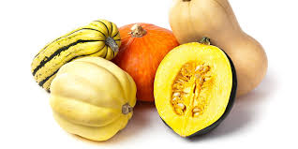
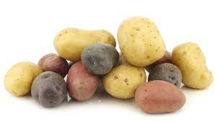
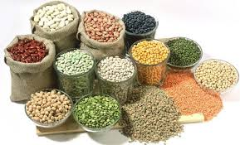
Complex carbohydrates
Complex carbohydrates are whole foods such as grains, potatoes and squash. They are full of fiber.
Notes:
Squashes, potatoes and grains are just as important as vegetables in helping to supply vitamins and minerals to the body. And they are full of fiber. It is through over processing these foods that they become unhealthy, like potato chips and French fries.

Slide 7
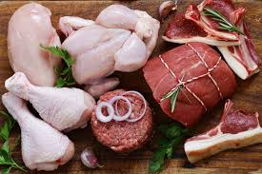
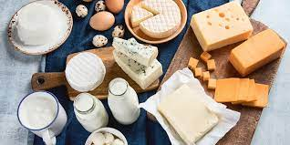
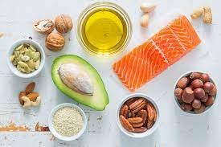
Proteins and fats
Protein is found in all foods, but comes primarily from meats and dairy. Fats come from both plant and animal sources. Both add to feelings of fullness.
Notes:
Protein is full of amino acids, structures that make up tissues of the body. The main source of protein is meats and dairy, but some can be found in all foods. Protein helps with feeling full and providing energy.

Slide 8
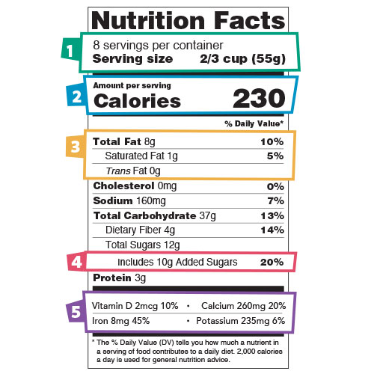
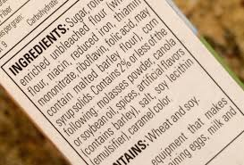
The more you know
Knowledge is power. Learn to read labels and understand what is in the box.
Ratio of nutrients.
Notes:
Knowledge is power. Once you learn to read labels and understand what is in the box, for the amount of food you are eating and what it is made of, you can make better choices for health. Simple tips: look at how much protein an item has compared to carbohydrates (watch the added sugars!). Try to have equal amounts of both, ingredients are listed by volume, whatever is listed first is what the main ingredient is and it has the most of!

Slide 9
Eat for health
Eat for health, pick from different foods and colors, and be healthy and well.
Notes:
Keep things simple and focus on eating for health, pick from different foods and colors, and be healthy and well. This will help the body start to heal and recover.

Slide 10
CONTACT
Tribal Opioid Response Program
Rocky Mountain Tribal Leaders Council
2929 3rd Avenue North Suite 300
Billings, MT 59101
Phone : 406.252.2550

