Slide 1
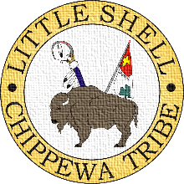
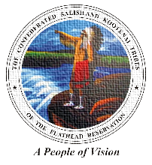
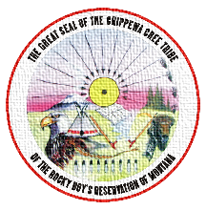
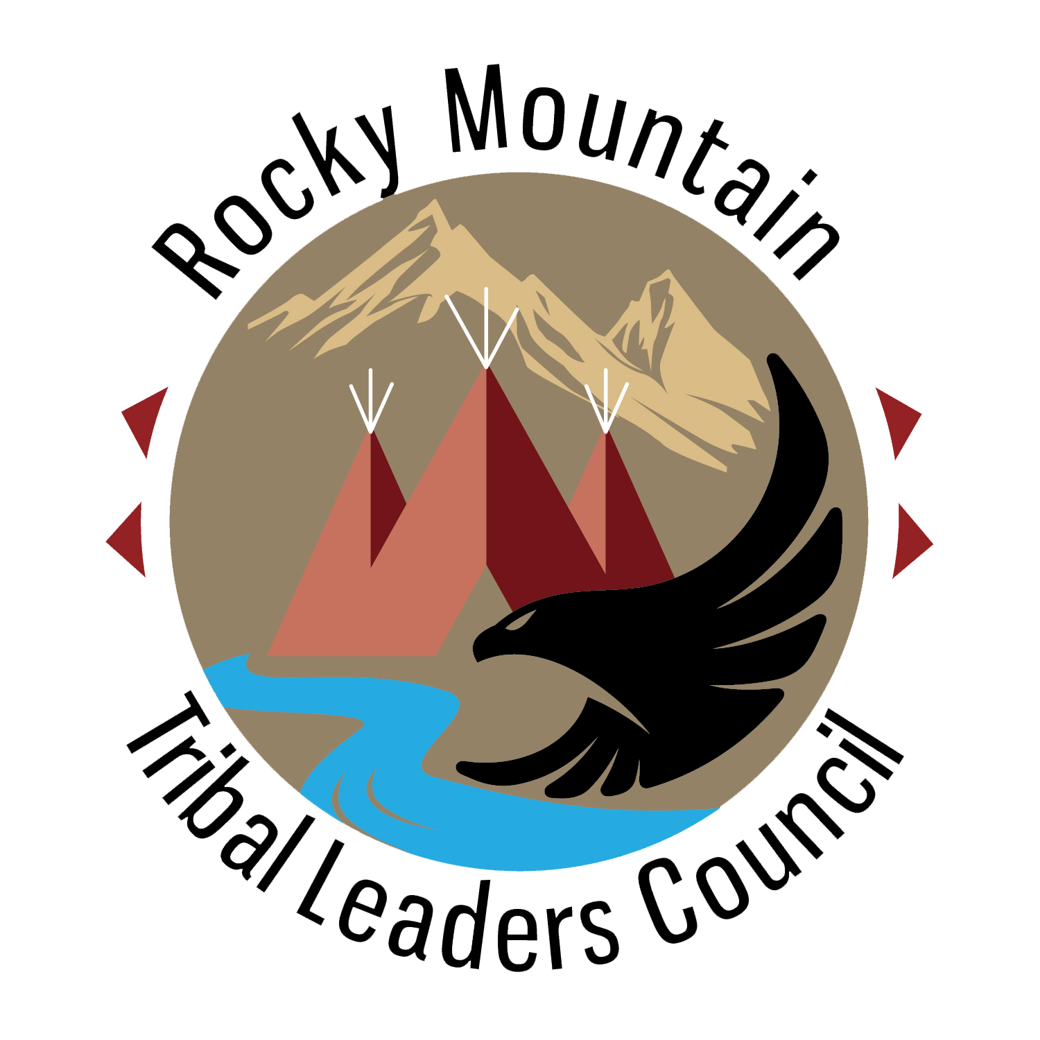
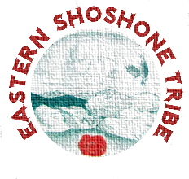
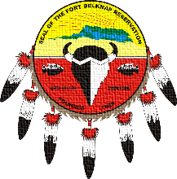
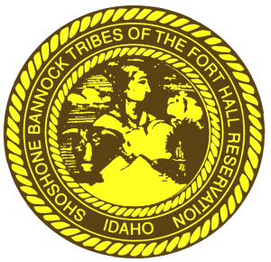
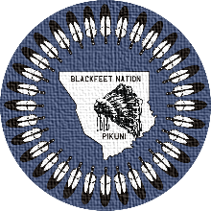
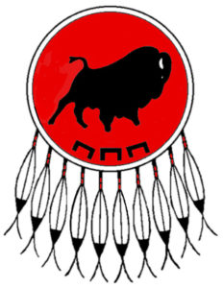
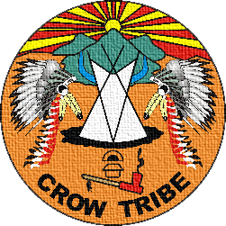
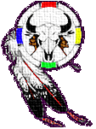
Nutrition 101 Part 1
ROCKY MOUNTAIN
TRIBAL LEADERS COUNCIL
Tribal Opioid Response Program
Notes:
Rocky Mountain Tribal Leader’s Council Tribal Opioid Response Program presents Nutrition 101, Part 1, Healthy Nutrition for Healthy Healing and Healthy Living

Slide 2
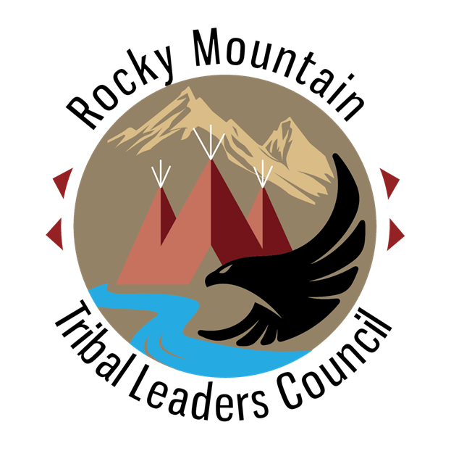
Healthy Nutrition for Healthy Healing and healthy living
Let food be your medicine and your medicine by thy food.
Notes:
Healthy nutrition is an important part of the recovery process. By focusing on eating healthier foods, the body will have the right nutrients to begin healing through healing, a healthier lifestyle will be possible.

Slide 3
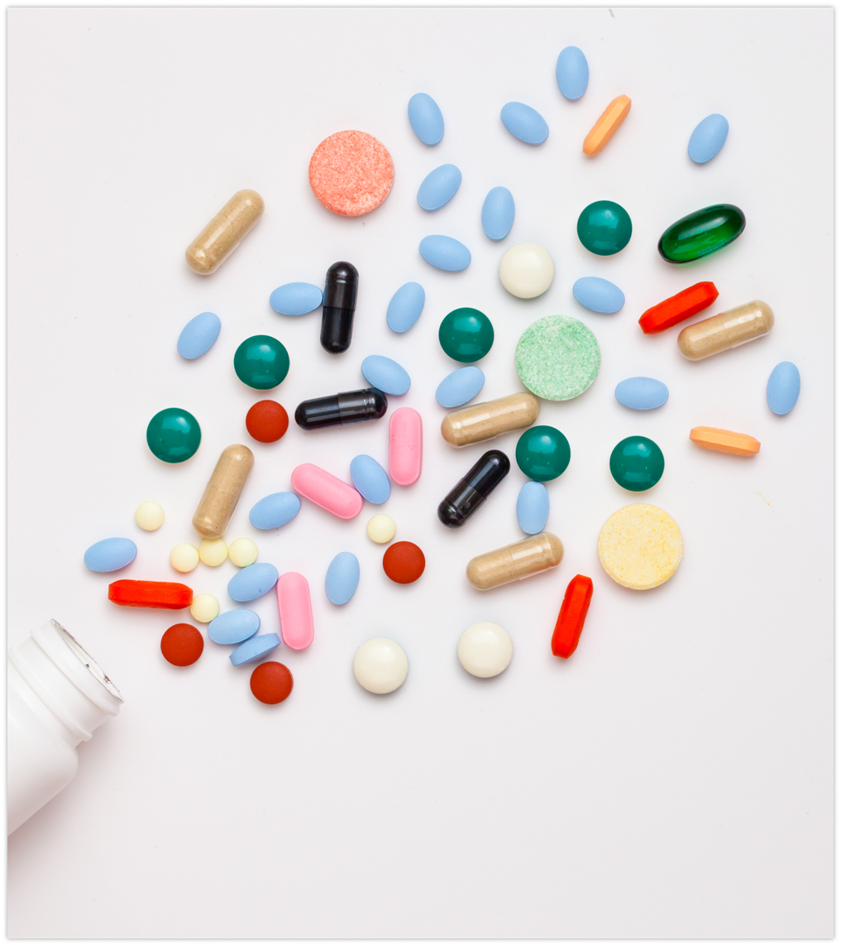
Drug misuse damages the body.
Notes:
Drug misuse damages the body because the body has to use it’s own resources to handle the substances taken. This often leads to a lack of minerals, vitamins and other nutrients. Drug use can also cause a lack of appetite which leads to further nutrient depletion.

Slide 4
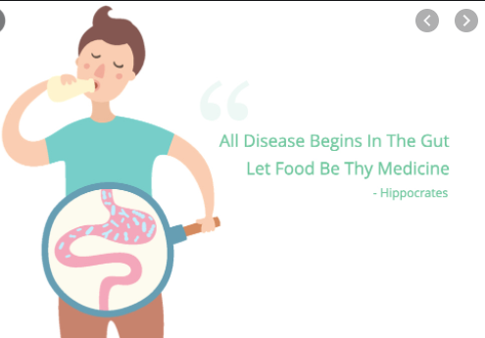
Drug misuse:
Affects body’s ability to be healthy.
Causes problems with digestion.
Digestion problems affect the skin and hair.
Internal issues affect mental health.
Notes:
Drug misuse causes further damage to the systems of the body, one of which is the digestive system. When the stomach and intestines are damaged, less nutrients from food are absorbed which affects tissues like the skin and hair. The brain is also affected by a lack of nutrients which can lead to mental health issues.

Slide 5
Let food be your medicine and medicine be your food.
Often attributed to Hippocrates, an ancient Greek physician, can be applied to many cultures that use plants and food as medicine, even today.
Notes:
Let food be your medicine and medicine be your food. This quote, often attributed to Hippocrates, and ancient Greek physician, can be applied to many other cultures that have used food for healing purposes.

Slide 6
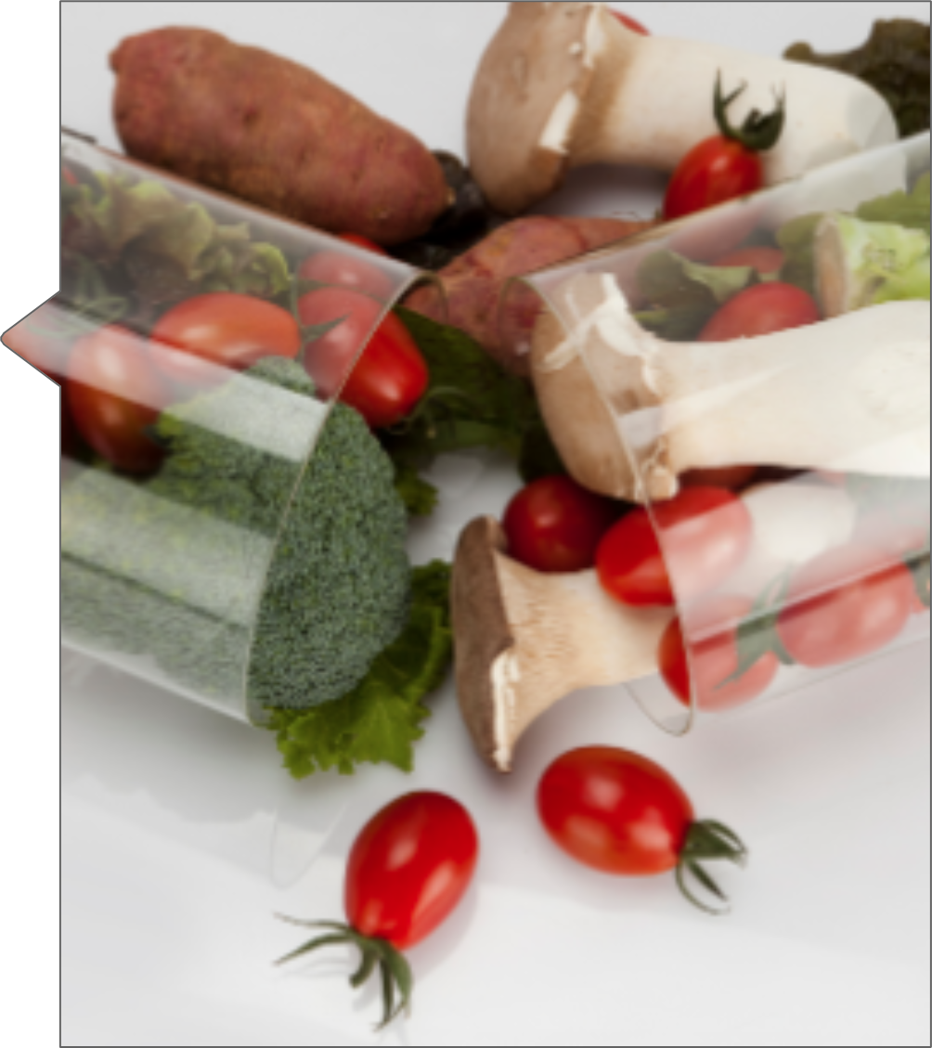
Food for Healing
Whole foods are rich in vitamins and minerals as well as other nutrients, know as phytochemicals, that the body uses to repair and rebuild itself each day.
Notes:
Whole foods are the best way to get the proper nutrients that the body needs. Vitamins, minerals and phytochemicals, or phytonutrients, are some of the building blocks that the body uses for day to day function and also to rebuild tissues, fight off infections and maintain energy.

Slide 7
Nutrients for Recovery and Repair
Notes:
But rather think about all of the individual nutrients that the body needs, it is better to think about eating a variety of foods.

Slide 8
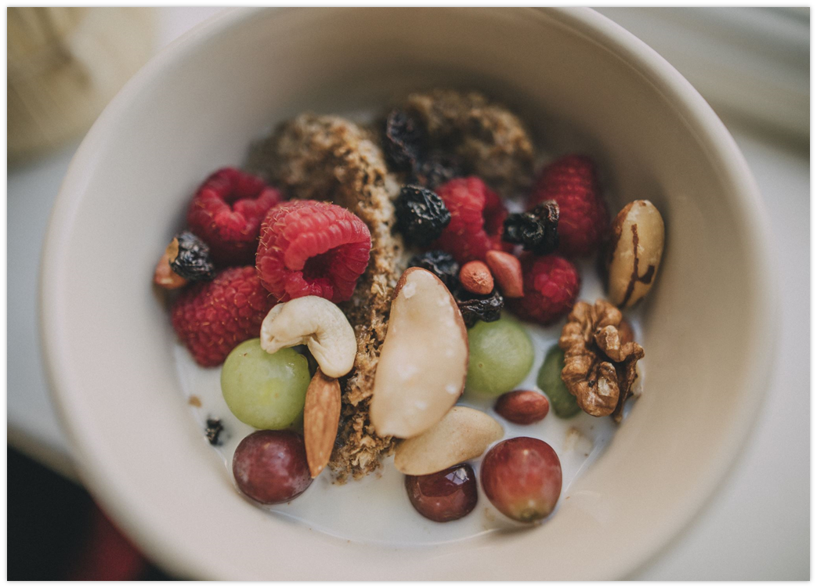
Whole Foods
Whole foods, or real foods, are foods that are in their natural state. These contain many of the vitamins and minerals that the body needs to heal.
Notes:
Focus on WHOLE NATURAL FOODS. Whole foods are those that are what they are. They do not come in any kind of package and do not have more than one ingredient. And they often don’t even come in a package!

Slide 9
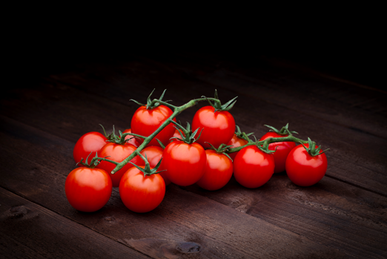
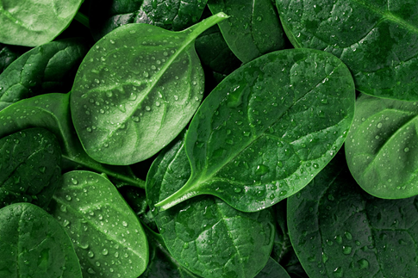
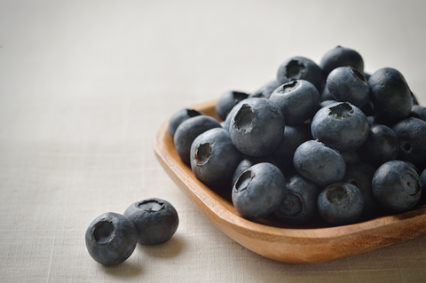
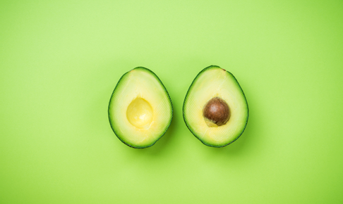
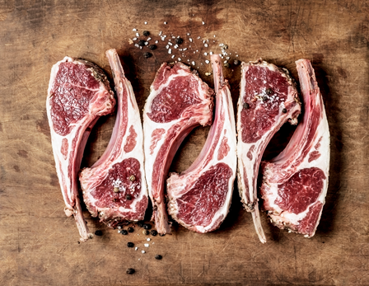
Proteins Fruits Vegetables Fats Grains
Notes:
Foods such as proteins, fruits, vegetables, fats and grains already contain all of the vitamins, minerals and phytonutrients that the body needs, and often in the right proportions.

Slide 10
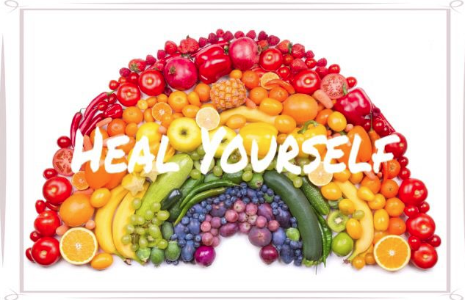
Eat a rainbow of foods!
Eating a wide variety of foods ensures that you get a wide variety of nutrients.
Notes:
EAT THE RAINBOW and you will be sure that you get all of the vitamins and minerals that you need. Sprinkle a little bit of color throughout each of your daily meals to brighten your day and improve your health and well being.

Slide 11
CONTACT
Tribal Opioid Response Program
Rocky Mountain Tribal Leaders Council
2929 3rd Avenue North Suite 300
Billings, MT 59101
Phone : 406.252.2550
Notes:
Thank you. Be well and be healthy.

